Slide 1

MINI PROJECT
ITP & NPV
GROUP-2
Rushika Vijay Bokde
Nikhil Rajesh Chauhan
Marre Devipriya

Slide 2
ASSET MANAGEMENT COMPANY CASE STUDY

Slide 3
PROBLEM STATEMENT
The Objective is to identify the best countries and a suitable investment type for making the investment. The overall strategy is to invest where others are investing, implying that the best countries are the ones “where most countries are investing”.
3

Slide 4
ABSTRACT
An Asset Management Company is a firm that invests pooled funds from clients,
putting the capital to work through different investments including stocks, bonds, real estate and more. Because they have a large pool of resources than the individual investor could access on their own, AMC’s provide investors with more diversification and investing options.

Slide 5
METHODOLOGY
Data science Tools used for this case study in order to achieve our objective -
Python
Numpy
Pandas
Editor used to use these tools effectively -
Jupyter Notebook
5

Slide 6
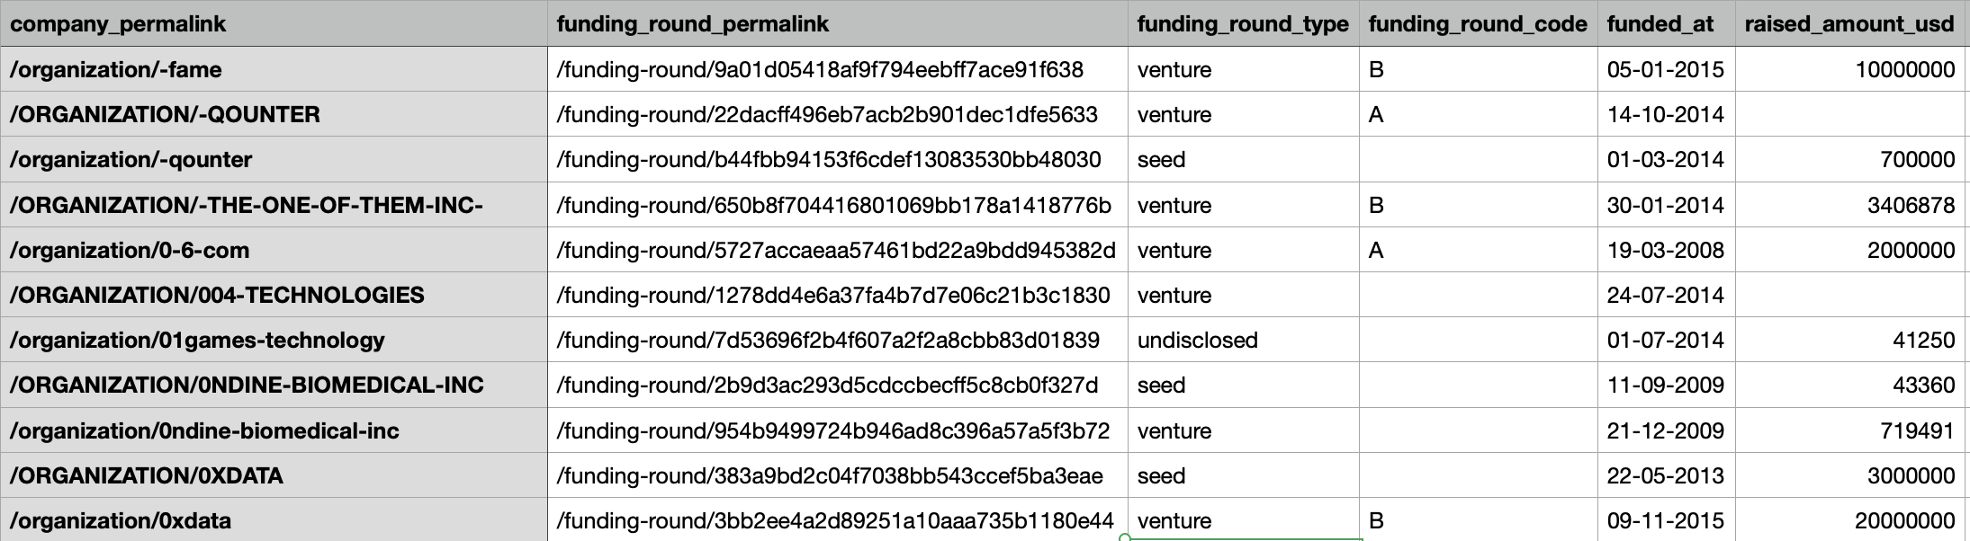
DATSETS
COMPANIES
In this dataset we are provided with the companies details with their permalink and funding details.
Sample data -
Caption

Slide 7
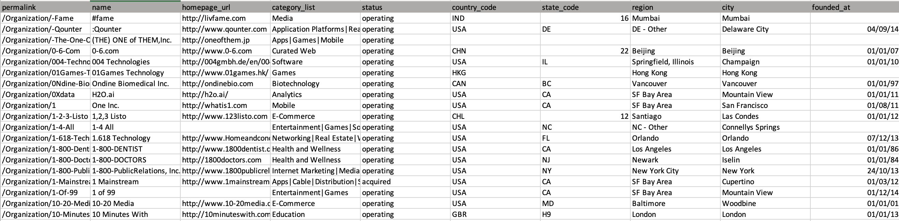
DATASETS
2. Companies dataset -
In this dataset we are provided with the Company name and all its attributes
Such as location, founding date, status etc to get better insights on the data.
7
Caption

Slide 8
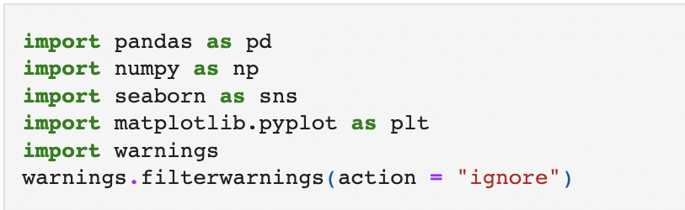
PACKAGES
Importing the required data analysis packages used to get the better insights of the data
and also understanding the package usage with time.
Pandas - Data Manipulation
Numpy - Mathematical Computation
Seaborn - Data Visualisation
Matplotlib - Matrix plotting library
8

Slide 9


COMPANIES IN BOTH DATASETS
1. As observed from the data of Companies list provided there are total of 66,368 companies listed.
2. The other data is provided with the list of companies funded with their funding attributes. The funded companies are in total 90,247.
9
Caption

Slide 10
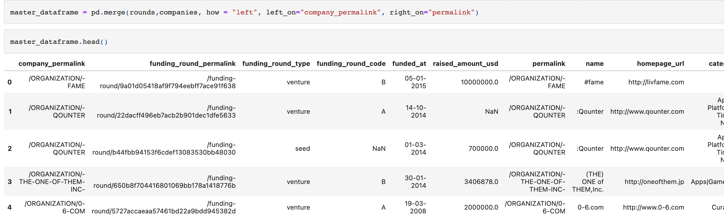
Merging Dataframes
We have merged the two different datasets into one dataset on
the common variable as both are linked to each other and with
this step we can get great insight of the data provided to us and
will help in understanding the objective better.
10
Caption

Slide 11
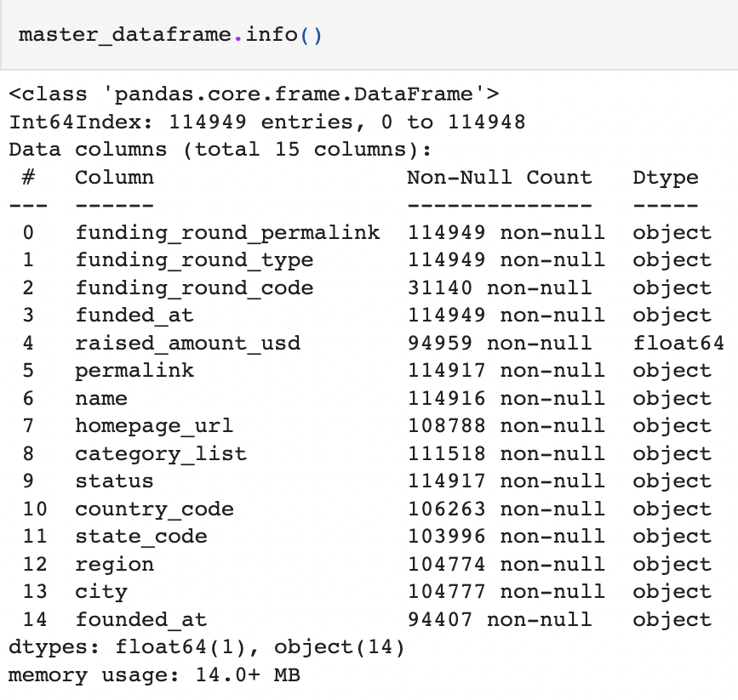
Missing Values in Dataset
Missing values are the data that are not present in a variable for a dataset.
In pandas it is usually represented as NaN (not a number).
With pandas we can use info() method to know the records present in the variables with
their datatype and and a specific table called as non null count. It briefly shows us the number of
non null records present for each variable.
11
Caption

Slide 12
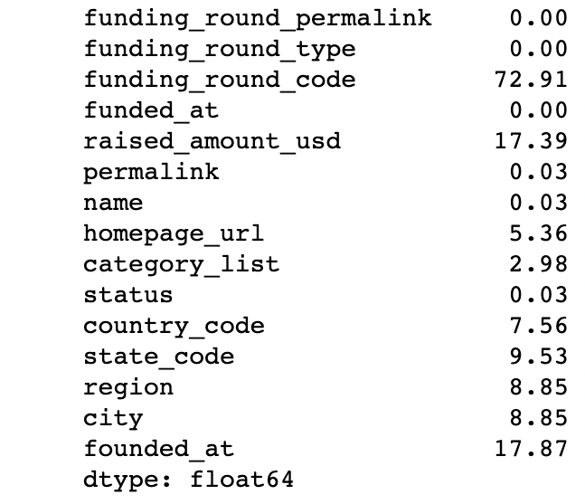
Using the info method we have found the columns having null records but to find the accurate
missing values in each variable we have used following code -
After running the following line of code we can see the percentage missing value of each column.
12
Caption

Slide 13
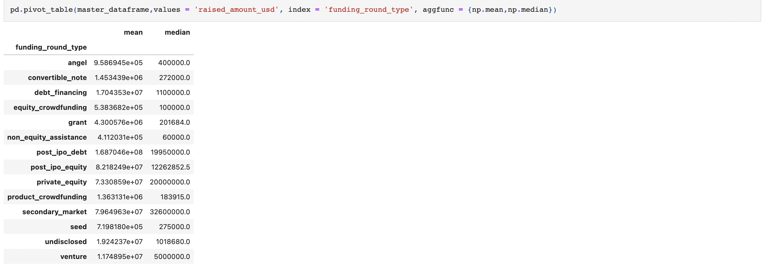
PIVOT TABLE CREATION
The pivot table takes simple column-wise data as input,
and groups the entries into a two-dimensional table that provides
a multidimensional summarisation of the data.
We have used pivot table in our data frame to compare the Mean and Median values for the record
“raised_amount_used” and “funding _round_type” across different funding round categories.
13
Caption

Slide 14
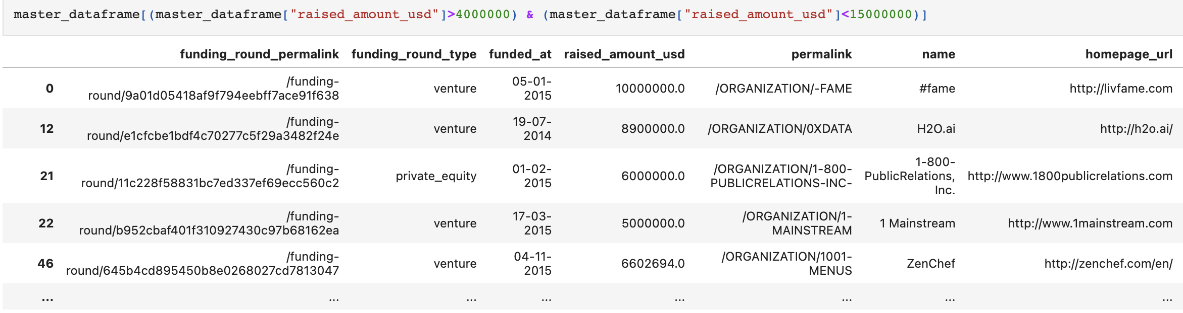
FILTERING
In the given dataset we have filtered out the amount raised by
the companies within the boundary of 4 million to 15 million.
The record filtered out are used from the variable
“raised_amount_usd”.
14
Caption

Slide 15
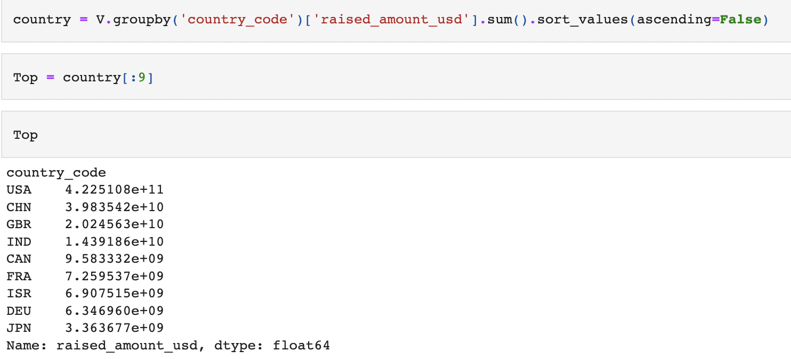
HIGHEST INVESTMENT
Identifying the top 9 countries in terms of highest investment in
“VENTURE” fund type.
This type of estimate is done by sort_values() method where we
Slice top records that we want after sorting.
15
Caption

Slide 16
TOP 9 COUNTRIES
CANADA
UNITED KINGDOM
GERMANY
CHINA
JAPAN
FRANCE
USA
ISRAEL
INDIA
These are the top countries where investment are highest in compare to the rest of the world in “Venture” type funding.
16

Slide 17
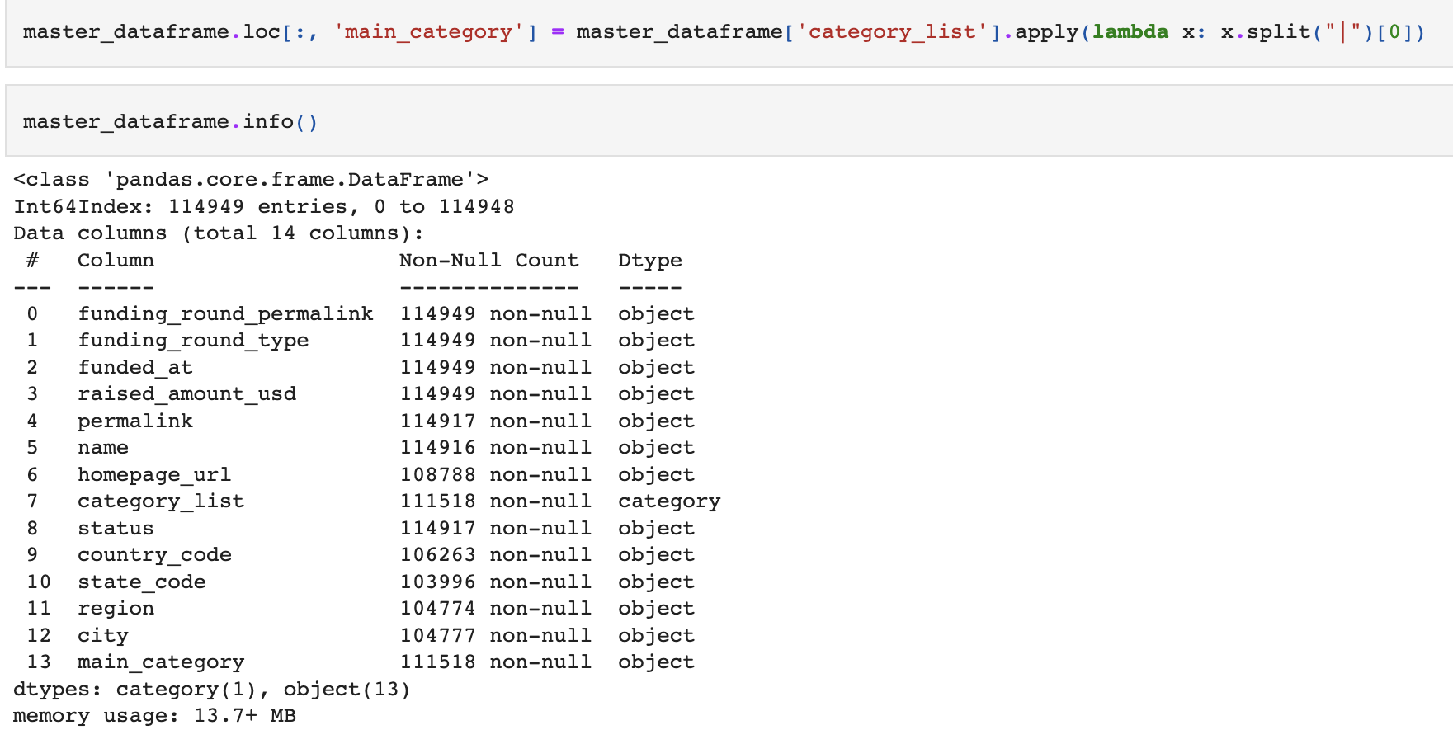
LAMBDA FUNCTION
Lambda function is an anonymous function defined without a name.
It can take any number of arguments but can have only one expression.
Here lambda function is used to extract the main sector of the companies listed
In the column “category_list”.
17
Caption

Slide 18
USER-DEFINED FUNCTION
A function is a set of statements that take inputs, do some computations and give out the desired
Results.
A user defined function, as the name suggests is defined by the user to perform specific tasks.
In the project task the user-defined function is used to convert the “raised_amount_usd”
column to categorical column with following conditions -
if the amount is less than 5 millions then recode as TypeA
If the amount is greater than 5 millions and greater than 7 millions then recode as TypeB
If the amount is greater than 7 millions then recode as TypeB
18

Slide 19
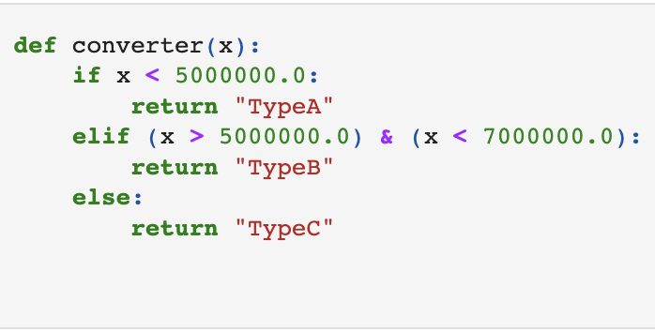
A function is defined “converter” to perform following tasks :-
Used if else statement in the defined function with an argument(x) to get the desired result.
19

Slide 20
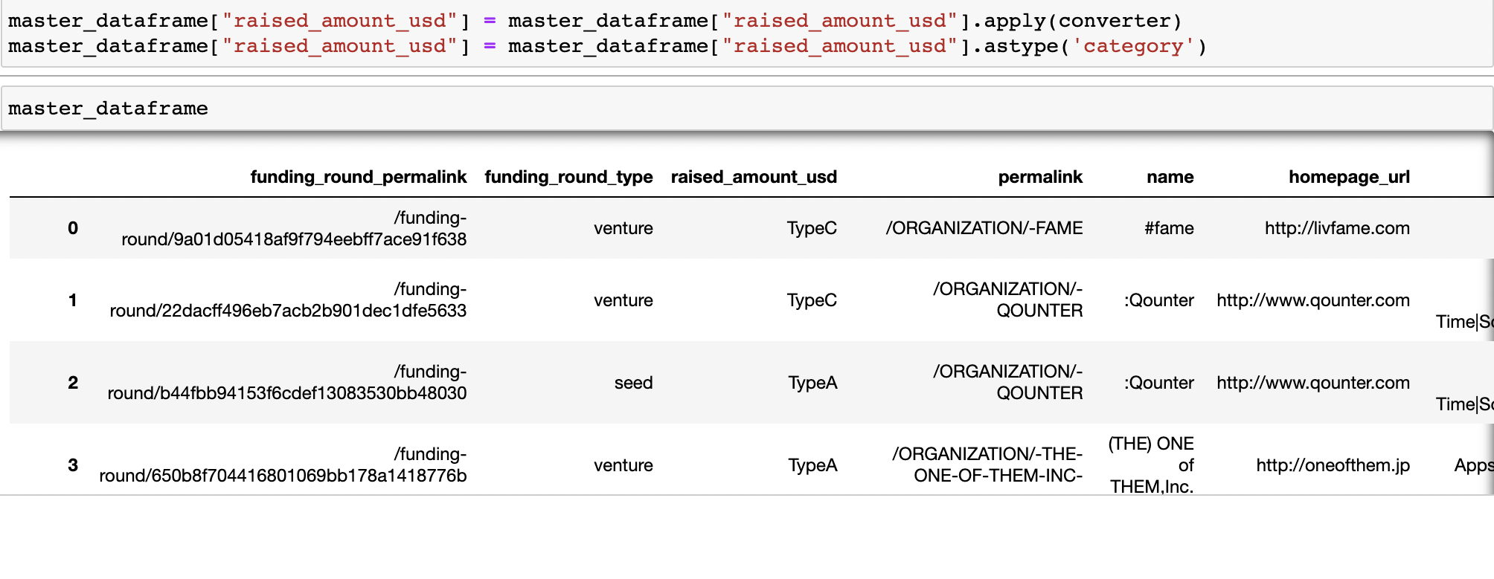
After defining the function we got the desired output, we use “apply” method to give argument as a
function we defined.
Now we need to convert the datatype of the column to categorical.
This is done by using “astype”method to convert datatype of the variables.
20
Caption

Slide 21
THANK YOU

